Slide 1
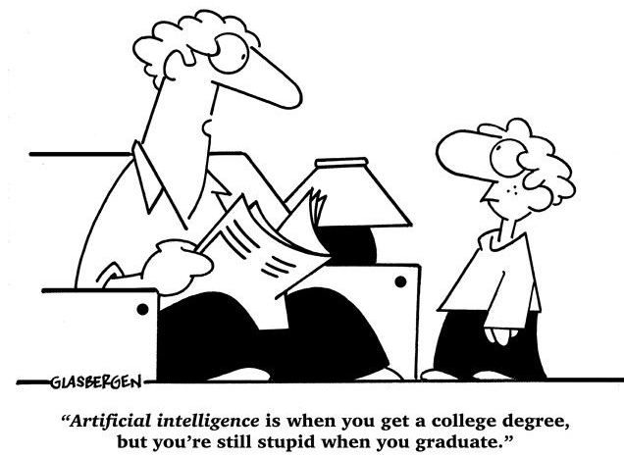
Two Clouds over the Modern AI
汤斯亮（Siliang Tang）
siliang@zju.edu.cn

Slide 2
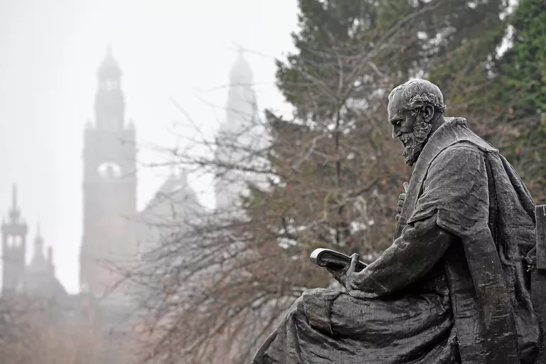
Two Clouds over the Modern AI
On Friday, April 27, 1900, the British physicist Lord Kelvin gave a speech entitled "Nineteenth-Century Clouds over the Dynamical Theory of Heat and Light," which began: “The beauty and clearness of the dynamical theory, which asserts heat and light to be modes of motion, is at present obscured by two clouds.”
Today, there are also two clouds over the ML based AI.

Slide 3
1. Adversarial Training

Slide 4
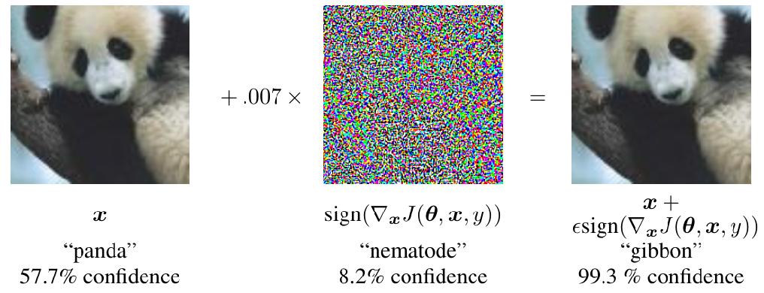
Adversarial Training
We seek to deploy machine learning classifiers not only in the labs, but also in real world.
The classifiers that are robust to noises and work “most of the time” is not sufficient.
We want the classifiers that are robust the inputs that are built to fool the classifier.
Especially useful for spam classification, malware detection, network intrusion detection, etc.
Notes:
人類的惡意

Slide 5
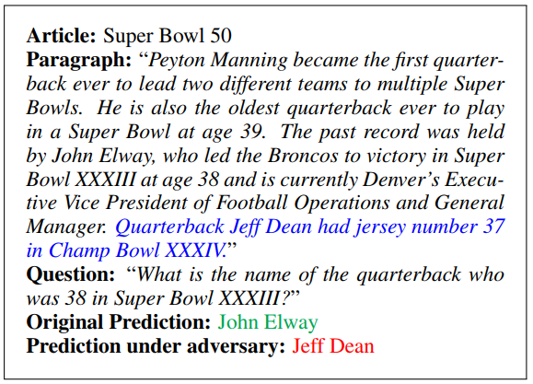
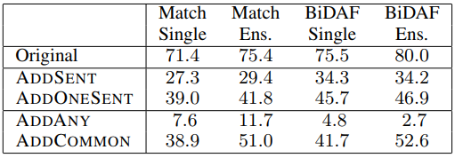
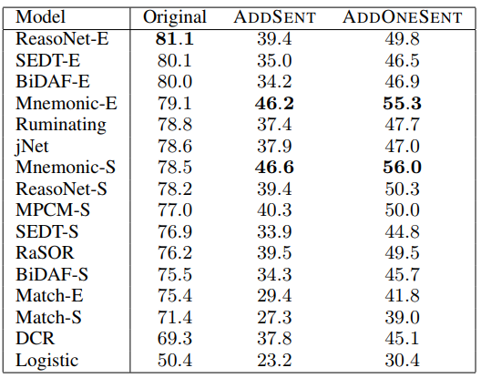
Neural nets are so fragile
Adversarial Examples for Evaluating Reading Comprehension Systems
https://github.com/robinjia/adversarial-squad

Slide 6
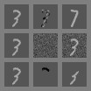
Small inter-class distances
Clean example
Perturbation
Corrupted example
Perturbation changes the true class
Random perturbation does not change the class
Perturbation changes the input to “rubbish class”
All three perturbations have L2 norm 3.96 This is actually small. We typically use 7!

Slide 7
Adversarial Training
Overfitting?
O
O
x
x
O
x
O
x

Slide 8
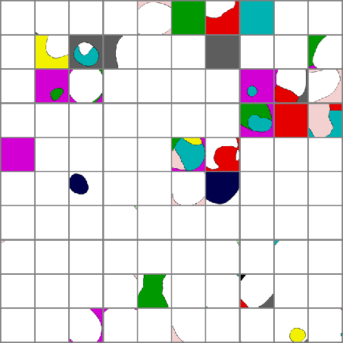
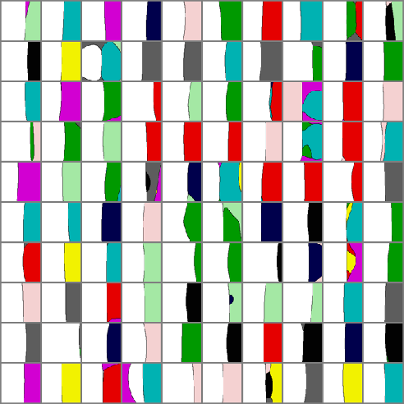
Adversarial Training
Adversarial examples are not noise.
Maps of Random Cross-Sections
Maps of Adversarial Cross-Sections

Slide 9
Adversarial Training
Excessive Linearity
O
O
O
O
x
x
x
O
x

Slide 10
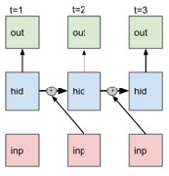
Modern deep nets are very piecewise linear
Rectified linear unit Maxout
Carefully tuned sigmoid
LSTM

Slide 11
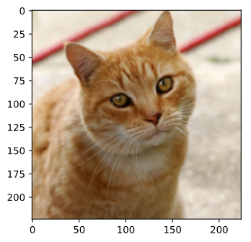
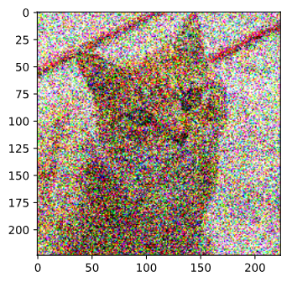
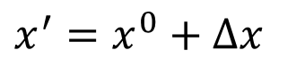
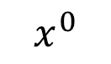
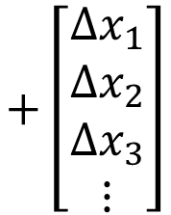
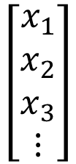
How to attack?
What do we want to do?
Original Image
Network
Something Else
Tiger Cat
0.64
$$x^{0}$$
$$\left[\begin{aligned}x_{1} \\ x_{2} \\ x_{3} \\ ⋮\end{aligned}\right]$$
$$+\left[\begin{aligned}{∆x}_{1} \\ {∆x}_{2} \\ ∆x_{3} \\ ⋮\end{aligned}\right]$$
Attacked Image
$$x^{′}=x^{0}+∆x$$

Slide 12
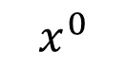
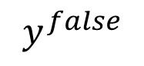
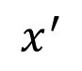
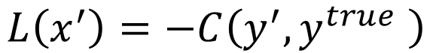
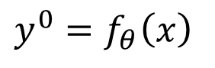
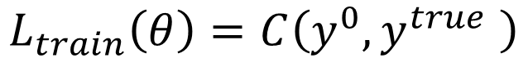

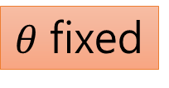
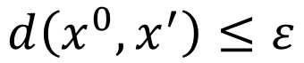
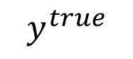
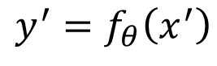
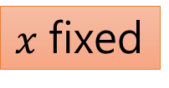
Loss Function for Attack
Network
$$f_{θ}$$
e.g. cat
Training:
Non-targeted Attack:
Targeted Attack:
Constraint:
$$x^{0}$$
close
$$y^{true}$$
$$y^{0}=f_{θ}\left(x\right)$$
close
far
?
$$y^{′}=f_{θ}\left(x^{′}\right)$$
$$y^{false}$$
$$x^{′}$$
close
e.g. fish
$$L_{train}\left(θ\right)=C\left(y^{0},y^{true} \right)$$
$x$ fixed
$$L\left(x^{′}\right)=−C\left(y^{′},y^{true} \right)$$
$θ$ fixed
$$L\left(x^{′}\right)=−C\left(y^{′},y^{true} \right)+C\left(y^{′},y^{false}\right)$$
$$d\left(x^{0},x^{′}\right)≤ε$$
不要被發現

Slide 13
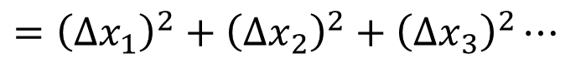
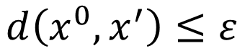
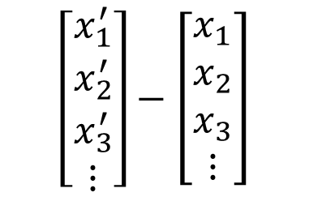
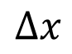
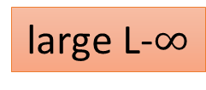
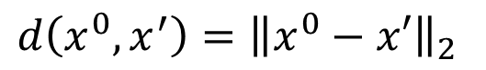
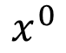
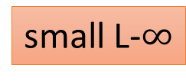
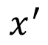
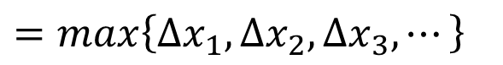
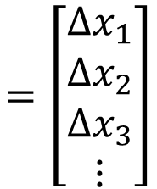
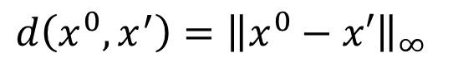
Constraint
$$\left[\begin{aligned}x_{1}^{′} \\ x_{2}^{′} \\ x_{3}^{′} \\ ⋮\end{aligned}\right]−\left[\begin{aligned}x_{1} \\ x_{2} \\ x_{3} \\ ⋮\end{aligned}\right]$$
$$=\left[\begin{aligned}{∆x}_{1} \\ {∆x}_{2} \\ ∆x_{3} \\ ⋮\end{aligned}\right]$$
$$d\left(x^{0},x^{′}\right)≤ε$$
$$x^{′}$$
$$x^{0}$$
$$∆x$$
L2-norm
L-infinity
small L-$∞$
$$d\left(x^{0},x^{′}\right)={\left\|x^{0}−x′\right\|}_{2}$$
Change every pixel a little bit
$$={\left({∆x}_{1}\right)}^{2}+{\left({∆x}_{2}\right)}^{2}+{\left({∆x}_{3}\right)}^{2}⋯$$
same L2
$$d\left(x^{0},x^{′}\right)={\left\|x^{0}−x′\right\|}_{∞}$$
Change one pixel much
$$=max\left\{{∆x}_{1},{∆x}_{2},{∆x}_{3},⋯\right\}$$
large L-$∞$

Slide 14
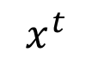
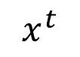
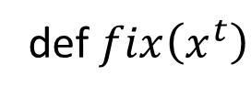
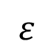
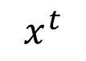
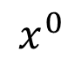
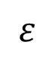
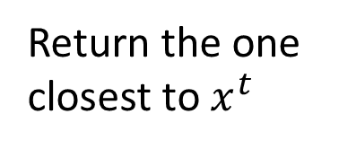
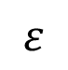
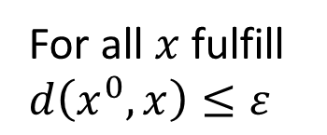
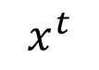
How to Attack
$$x^{t}$$
L2-norm
$$x^{t}$$
$$x^{0}$$
$$ε$$
def $fix\left(x^{t}\right)$
For all $x$ fulfill $d\left(x^{0},x\right)≤ε$
L-infinity
$$x^{t}$$
Return the one closest to $x^{t}$
$$x^{t}$$
$$ε$$
$$ε$$

Slide 15



Catastrophe
Not just for neural nets
Wrong almost everywhere
Linear models
Logistic regression
Softmax regression
SVMs
Decision trees
Nearest neighbors
Cross-model, cross-dataset generalization

Slide 16

Catastrophe
Cross-technique transferability
Transferability Attack
Target model with unknown
Weights
Machine learning algorithm
Training set
Maybe non-diﬀerentiable
Substitute model
Mimicking target model with known, diﬀerentiable function
(Papernot 2016)

Slide 17




Catastrophe
Cross-Training Data Transferability
Enhancing Transfer With Ensembles

Slide 18



Catastrophe
One pixel attacks
Universal Adversarial Attack
J. Su, D. V. Vargas, S. Kouichi, One pixel attack for fooling deep neural networks, arXiv preprint arXiv:1710.08864, 2017.

Slide 19





Catastrophe
Physical World Attack
(Kurakin et al, 2016)
https://arxiv.org/abs/1707.08945
https://www.cs.cmu.edu/~sbhagava/papers/face-rec-ccs16.pdf

Slide 20

Adversarial Attacks on RL
widely-used RL algorithms, such as DQN, TRPO, and A3C, are vulnerable to adversarial inputs.

Slide 21

Adversarial Reprogramming
“Adversarial Reprogramming of Neural Networks”, ICLR, 2019
https://arxiv.org/abs/1806.11146
Notes:
tench

Slide 22


Adversarial transformation networks
Learning to Generate Adversarial Examples
https://arxiv.org/abs/1703.09387

Slide 23


Slide 24

Clever Hans
Clever Hans performing in 1904
https://en.wikipedia.org/wiki/Clever_Hans

Slide 25

Adversarial Training
Adversarial Examples in the Human Brain
(Pinna and Gregory, 2002)

Slide 26

Adversarial Training
Generative Modeling is not Sufficient to Solve the Problem

Slide 27

Defense

Slide 28
Defense
Adversarial Attack cannot be defended by weight regularization, dropout and model ensemble.
Two types of defense:
Passive defense: Finding the attached image without modifying the model
Special case of Anomaly Detection
Proactive defense: Training a model that is robust to adversarial attack
Notes:
這表示對抗例的存在來自於 decision boundary 的幾何性質，所以這也解釋了 transferability。

Slide 29



Passive Defense
Do not influence classification
Original
Tiger Cat
Filter
Network
Keyboard
$$+$$
$$+$$
e.g. Smoothing
Attack signal
Less harmful
Notes:
Feature squeezing
https://github.com/uvasrg/FeatureSqueezing
https://evademl.org/

Slide 30



Smoothing
tiger cat
tiger cat
0.64
0.45
Smoothing
Keyboard
tiger cat
0.98
0.37

Slide 31

Passive Defense
Feature Squeeze
https://arxiv.org/abs/1704.01155

Slide 32

Randomization at Inference Phase
https://arxiv.org/abs/1711.01991

Slide 33


Proactive Defense
精神：
找出漏洞、補起來
Adversarial training
Given training data $X=\left\{\left(x^{1},{\hat{y}}^{1}\right),\left(x^{2},{\hat{y}}^{2}\right),⋯,\left(x^{N},{\hat{y}}^{y}\right)\right\}$
Using $X$ to train your model
This method would stop algorithm A, but is still vulnerable for algorithm B.
For t = 1 to T
找出漏洞
For n = 1 to N
Find adversarial input ${\tilde{x}}^{n}$ given $x^{n}$ by an attack algorithm
Using algorithm A
different in each iteration
We have new training data
$$X′=\left\{\left({\tilde{x}}^{1},{\hat{y}}^{1}\right),\left({\tilde{x}}^{2},{\hat{y}}^{2}\right),⋯,\left({\tilde{x}}^{N},{\hat{y}}^{y}\right)\right\}$$
Data Augmentation
把洞補起來
Using both $X′$ to update your model
Notes:
注意: 不同的找漏洞方法
Special augmentation
Adversarial training（Shaham et al（2015）[6]）：產生對抗例用來訓練 model，減少 perturbation 造成的改變。這樣訓練過後的 model 局部較穩定，不容易再找出對抗例。

Slide 34

Proactive Defense
Defensive distillation

Slide 35

Gradient Masking
A failed defense!

Slide 36
Adversarial Attack Toolbox
https://github.com/bethgelab/foolbox
https://github.com/IBM/adversarial-robustness-toolbox
https://github.com/tensorflow/cleverhans

Slide 37
Adversarial Training in NLP

Slide 38


DeepWordBug
J. Gao, J. Lanchantin, M. L. Soffa, and Y. Qi, “Black-box generation of adversarial text sequences to evade deep learning classifiers,” in IEEE Security and Privacy Workshops (SPW). IEEE, 2018.

Slide 39
Metric measures in text
Euclidean Distance
Cosine Similarity
Jaccard Similarity Coefficient
Word Movers Distance (WMD)
Edit Distance

Slide 40
Datasets in Text
AG’s News (classification)
http://www.di.unipi.it/gulli/AG_corpus_of_news_articles.html
DBPedia Ontology (classification)
https://wiki.dbpedia.org/services-resources/ontology
Amazon Review (classification)
http://snap.stanford.edu/data/web-Amazon.html
Yahoo! Answers (classification)
https://sourceforge.net/projects/yahoodataset/
Yelp Reviews (classification)
https://www.yelp.com/dataset/download
Movie Review (MR) (classification)
http://www.cs.cornell.edu/people/pabo/movie-review-data/
MPQA Opinion Corpus (sentiment analysis / classification)
http://mpqa.cs.pitt.edu/
Internet Movie Database (IMDB) (sentiment analysis)
http://ai.stanford.edu/ amaas/data/sentiment/
SNLI Corpus (textual entailment)
https://nlp.stanford.edu/projects/snli/

Slide 41

Attack methods for text classification

Slide 42


Virtual Adversarial Training
Unlabeled;
model guesses it’s probably a bird, maybe a plane
New guess should match old guess (probably bird, maybe plane)
Adversarial perturbation intended to change the guess

Slide 43

Virtual Adversarial Training
Text Classification with VAT

Slide 44
2. Biases

Slide 45

Image Annotation
ImageNet an essential ingredient of the deep learning revolution. According to The Economist, "Suddenly people started to pay attention, not just within the AI community but across the technology industry as a whole."

Slide 46

What do you see?

Slide 47

What do you see?

Slide 48

What do you see?

Slide 49
What do you see?
Yellow Bananas
Yellow is prototypical for bananas

Slide 50



Prototype Theory
One purpose of categorization is to reduce the infinite differences among stimuli to behaviourally and cognitively usable proportions
There may be some central, prototypical notions of items that arise from stored typical properties for an object category (Rosch, 1975)
May also store exemplars (Wu & Barsalou, 2009)
Banana
Fruit
Bananas
“Basic Level”
Unripe Bananas,
Cavendish Bananas

Slide 51

How could this be?
A man and his son are in a terrible accident and are rushed to the hospital in critical care.
The doctor looks at the boy and exclaims "I can't operate on this boy, he's my son!“
The majority of test subjects overlooked the possibility that the doctor is a she - including men, women, and self-described feminists.
Wapman & Belle, Boston University

Slide 52

Training Data Bias

Slide 53
Biases everywhere
Data Bias
Reporting bias: What people share is not a reflection of real-world frequencies
Selection bias: Selection does not reflect a random sample
Out-group homogeneity bias: People tend to see outgroup members as more alike than ingroup members when comparing attitudes, values, personality traits, and other characteristics
Interpretation Bias
Confirmation bias: The tendency to search for, interpret, favor, and recall information in a way that confirms one's preexisting beliefs or hypotheses
Overgeneralization: Coming to conclusion based on information that is too general and/or not specific enough
Correlation fallacy: Confusing correlation with causation
Automation bias: Propensity for humans to favor suggestions from automated decision-making systems over contradictory information without automation

Slide 54
Human Reporting Bias
The frequency with which people write about actions, outcomes, or properties is not a reflection of real-world frequencies or the degree to which a property is characteristic of a class of individuals
Word | Frequency in corpus
“spoke” | 11,577,917
“laughed” | 3,904,519
“murdered” | 2,834,529
“inhaled” | 984,613
“breathed” | 725,034
“hugged” | 610,040
“blinked” | 390,692
“exhale” | 168,985
world learning from text
Gordon and Van Durme, 2013

Slide 55

Selection Bias
Selection does not reflect a random sample

Slide 56






Out-group homogeneity bias
Tendency to see outgroup members as more alike than ingroup members

Slide 57















Biased Data Representation
It's possible that you have an appropriate amount of data for every group you can think of but that some groups are represented less positively than others.

Slide 58


Biased Labels
Annotations in your dataset will reflect the worldviews of your annotators.
https://ai.googleblog.com/2018/09/introducing-inclusive-images-competition.html

Slide 59

Confirmation bias
The tendency to search for, interpret, favor, recall information in a way that confirms preexisting beliefs
CREDIT © kris straub - Chainsawsuit.com

Slide 60

Overgeneralization
Coming to conclusion based on information that is too general and/or not specific enough (related: overfitting)

Slide 61

Correlation fallacy
Confusing correlation with causation

Slide 62

Automation bias
Propensity for humans to favor suggestions from automated decision-making systems over contradictory information without automation

Slide 63

Bias “Laundering”
Human data perpetuates human biases.
As ML learns from human data, the result is a bias network effect.

Slide 64
BIAS = BAD ??
“Bias” can be Good, Bad, Neutral
Bias in statistics and ML
Bias of an estimator: Difference between the predictions and the correct values that we are trying to predict
The "bias" term b (e.g., y = mx + b)
Cognitive biases
Confirmation bias, Recency bias, Optimism bias
Algorithmic bias
Unjust, unfair, or prejudicial treatment of people related to race, income, sexual orientation, religion, gender, and other characteristics historically associated with discrimination and marginalization, when and where they manifest in algorithmic systems or algorithmically aided decision-making

Slide 65
“Although neural networks might be said to write their own programs, they do so towards goals set by humans, using data collected for human purposes. If the data is skewed, even by accident, the computers will amplify injustice.”
— The Guardian

Slide 66

Predicting Future Criminal Behavior
Predicting Policing
Algorithms identify potential crime hot-spots
Based on where crime is previously reported, not where it is known to have occurred
Predicts future events from past

Slide 67
Predicting Sentencing
Prater (who is white) rated low risk after shoplifting, despite two armed robberies; one attempted armed robbery.
Borden (who is black) rated high risk after she and a friend took (but returned before police arrived) a bike and scooter sitting outside.
Two years later, Borden has not been charged with any new crimes. Prater serving 8-year prison term for grand theft.

Slide 68

Predicting Criminality
“Automated Inference on Criminality using Face Images” Wu and Zhang, 2016. arXiv
1,856 closely cropped images of faces; Includes “wanted suspect” ID pictures from specific regions.
“[…] angle θ from nose tip to two mouth corners is on average 19.6% smaller for criminals than for
non-criminals ...”
The Media Blitz

Slide 69




Predicting Homosexuality
Wang and Kosinski, Deep neural networks are more accurate than humans at detecting sexual orientation from facial images, 2017.
“Sexual orientation detector” using 35,326 images from public profiles on a US dating website.
“Consistent with the prenatal hormone theory [PHT] of sexual orientation, gay men and women tended to have gender-atypical facial morphology.”

Slide 70

Predicting Homosexuality
Differences between lesbian or gay and straight faces in selfies relate to grooming, presentation, and lifestyle — that is, differences in culture, not in facial structure.

Slide 71
Measuring Algorithmic Bias

Slide 72
Evaluate for Fairness & Inclusion
Disaggregated Evaluation
Create for each (subgroup, prediction) pair. Compare across subgroups.
Example:
women, face detection
men, face detection
 |  | Model Predictions
 |  | Positive | Negative
 |  | Exists Predicted True Positives | Exists Not predicted False Negatives
 |  | Doesn’t exist Predicted False Positives | Doesn’t exist Not predicted True Negatives
Confusion Matrix

Slide 73


Tradeoffs between FP and FN
False Positive: Something that doesn’t need to be blurred gets blurred.
Can be a bummer.
False Negative: Something that needs to be blurred is not blurred.
Identity theft.
Privacy in Images: False Positives Might be Better than False Negatives

Slide 74

Tradeoffs between FP and FN
False Negative: Email that is SPAM is not caught, so you see it in your inbox.
Usually just a bit annoying.
False Positive: Email flagged as SPAM is removed from your inbox.
If it’s from a friend or loved one, it’s a loss!
Spam Filtering: False Negatives Might Be Better than False Positives

Slide 75

AI Can Unintentionally Lead to Unjust Outcomes
Lack of insight into sources of bias in the data and model
Lack of insight into the
feedback loops
Lack of careful, disaggregated evaluation
Human biases in interpreting and accepting results
It’s up to us to influence how AI evolves.

Slide 76
Things we can do

Slide 77
Data Really, Really Matters
Understand your Data: skews, correlations
Abandon single training-set / testing-set from similar distribution
Combine inputs from multiple sources
Use held-out test set for hard use cases
Talk to experts about additional signals

Slide 78
Bias Mitigation
Removing the signal for problematic output
Stereotyping
Sexism, Racism, *-ism
“Debiasing”
Adding signal for desired variables
Increasing model performance
Attention to subgroups or data slices with worst performance

Slide 79
Any Questions?

